Slide 1
Welcome and opening of the seminar
Kalle-Antti Suominen, vice-rector
Open Science Autumn Conference 2021
Nov. 24, 2021

Slide 2
University of Turku
100
1
st
Years in 2020
Finnish-language university
Academic heritage in Turku since 1640
Founded in 1920 by the initiative of the Finnish people with the support of 22,040 donors.
“From a free people to free science”
The first university in Finland, the Royal Academy of Turku, operated in the city 1640–1828.

Slide 3
Without openness we can not have free science!

Slide 4
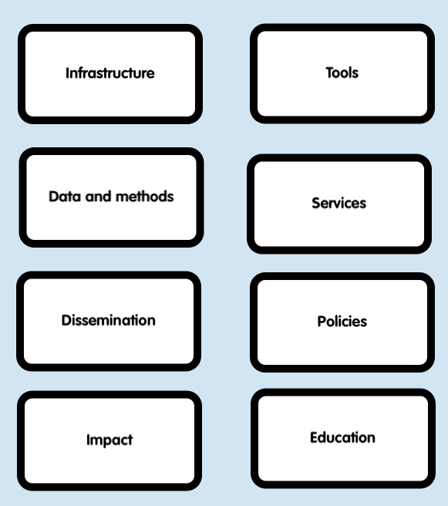
Open Science – a topic with many branches
Open science follows closely the research process starting with prerequisities and implementation, then dissemination and finally the multifaceted impact (including reuse of the research output e.g. for other research purposes or for innovation).
Parallel to that we have the tools for opening the various parts of the research path, services to support the activities, guiding policies, and finally the opening of research-based education.
Research and researcher assessment, ethical principles, GDPR, intellectual property rights etc.

Slide 5
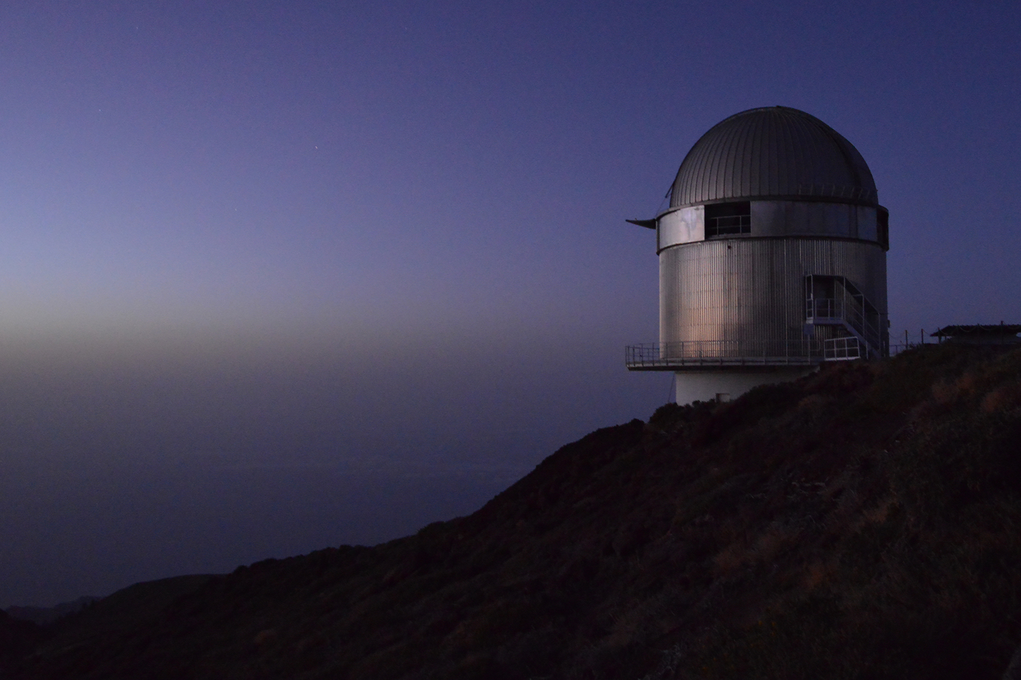
Infrastructure – our specific theme
Infrastructure – our specific theme
The infrastructure and tools needed for introducing openness to the different stages of the research path.
The open access to the infrastructure needed for performing the research itself
Equipment
Data collections
The infrastructure and tools needed to support openness to the different stages of the research path.
Open access to the research infrastructure:
Equipment
Data collections

