Slide 1
Open at any price? Reviewing short- and long-term implications of current forms of open access
Mikael Laakso, D.Sc. (Econ.)
Associate Professor
Hanken School of Economics, Helsinki, Finland
Presentation on the 4th of May 2021, Open Science Days
@mikaellaakso
mikaellaakso.com

Slide 2
Open is good, but not at any cost

Slide 3
Not only talking strictly about money. Also concerns equality of participation and well-functioning scholarly communication.

Slide 4
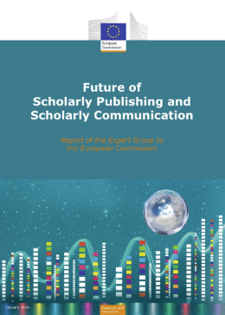
My background and perspective
Research has been focusing on how open access (OA) has been introduced and changed scholarly journal publishing.
Member of the Finnish open science policy coordination steering group (2018-2020).
Currently
Member in a national working group developing measures for monitoring total costs of OA publishing.
Board member of the Finnish Association for Scholarly Publishing
Editor in chief of the library and information science journal ‘Informaatiotutkimus’
https://doi.org/10.2777/836532

Slide 5
Agenda/Main points
Open access by itself is not the solution to making scholarly journal publishing more affordable
Major open access models, experiences so far, and trajectories for future development
Transformative agreements
Full open access journals
Green open access
Use of money originating from public sources = Science policy in action

Slide 6
Open Access is constantly evolving
Open Access
The Needs of Scholarly Communication
Financial Aspects
Science Policy
Technology Development
Laakso (2014) http://hdl.handle.net/10138/45238

Slide 7
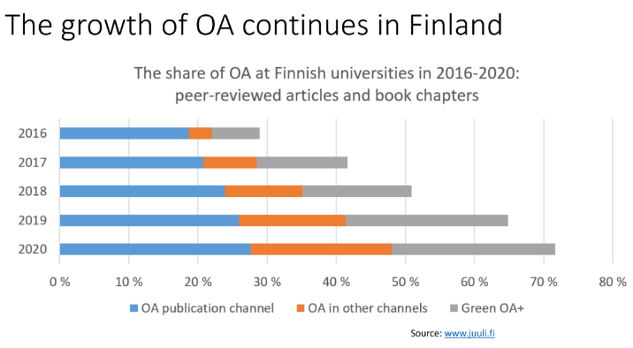
Growth and shift in models
Ilva, Koikkalainen, Pölönen, Syrjämäki,Vilén (2121) http://urn.fi/URN:NBN:fi-fe202104069535

Slide 8
Our perspective for today
Bibliometric
Economic

Slide 9
Open + Money
The issue of money has been intimately tied to OA from early on, yet there is only limited knowledge and experience about how to align the two.
Price and cost transparency is of benefit to everyone one else other than publishers who seek financial gain by not making such information readily available.
Added perception of cost vs price would be useful, thus making additional value added by providers more observable.

Slide 10
Think & ponder
With a desire to increase OA to research outputs sustainably, what is the most viable ways to allocate limited resources:
Right now
Looking ahead 10 years

Slide 11
Open = less expensive overall?
So far – definitely no!
Most of the 16 000+ open access journals active today are free to publish in, however, the problem is that most articles are published in those that do carry a fee (an APC) and we are still paying for subscriptions.
There has been a persistent lack of one, or even a few, big and obvious ”models” to bet on substantially. Scarce resources are now spread out thin.

Slide 12
The five largest publishers publish around half of all scholarly journals
Currently ~1/5th of these journals are full open access

Slide 13
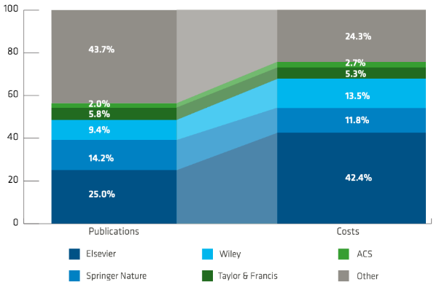
Large publishers account for an even larger share of the costs for libraries
https://eua.eu/resources/publications/889:decrypting-the-big-deal-landscape.html

Slide 14
The puzzle in aligning individual and organisational goals and actions with science policy.
International Science Policy
Publishers
National Science Policy
Research Funders
Universities
Libraries
Researchers

Slide 15
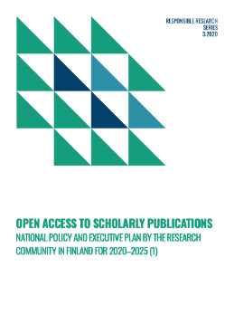
Finland is ahead of the curve in many ways
National policy for open access drafted with consideration for research funder requirements, negotiations with international publishers, and goals for the development of national journal publishing.
There should be compatibility with today's practices and realities to reduce dissonance and confusion among the national research community (Lilja 2021).
https://avointiede.fi/sites/default/files/2020-03/openaccess2019.pdf
https://doi.org/10.1093/scipol/scaa044

Slide 16
Ways of funding open access publishing
A useful differentiation:
Front-end funding (Supporting the system from the front)
Back-end funding (Supporting the system from the back)

Slide 17
The frenzy to support OA through front-end funding has been strong
Paying to commercial publishers for hybrid OA (incl. transformative agreements) and APCs.
Solves/delays immediate problems, for some actors.
Fast? Yes.
Cheap? No.
Any steering wheel? No.
Image: https://www.imdb.com/title/tt0322802/mediaviewer/rm2164529152/

Slide 18
Market control is not on the buyers’ side
Still mostly non-transparent pricing and contract terms.
Each journal (and thus publisher) essentially a monopoly. Both for reading and for publishing in.
Pricing extrapolated from historical spending.
De-synced international negotiation schedules.
Content supply disconnected from purchasing decisions.
Publication outlet rank deeply entangeled in academic merit systems.
Decoupled buyer and primary end-consumer

Slide 19
A hard fact
Commercial companies, particularly publicly traded, are out to increase profits and seek growth.
That is what makes shareholders happy, and the leadership of the companies keep their jobs.
This growth can come from expanding business into new areas, or it can come from increasing market share and/or prices in existing segments.
https://www.change.org/p/elsevier-boycott-elsevier-and-support-affordable-open-access-scholarly-publishing/sign

Slide 20
Transformative agreements

Slide 21
First things first: Consortias are good. The larger, yet unified in goals, the better

Slide 22
Transformative agreements
Pre-transformative agreements
Traditional subscription licenses that grant APC discounts or vouchers for OA publication of a limited number of articles.
Partially transformative agreements
Differentiate between a read fee and a publish fee to cover the APCs of a certain number of articles.
Fully transformative agreements
Allow unlimited OA publication of the scholarly output of the subscribing institution.
Some agreements limited to hybrid journals, some allow publication in both hybrid and full OA journals
Borrego, Anglada & Abadal (2021) https://doi.org/10.1002/leap.1347

Slide 23
“Transformative agreements: Do they pave the way to open access?”
“Transformative agreements are more transparent than traditional journal licences, allow authors to retain copyright, and make provisions to facilitate the management of open access workflows.”
“Transformative agreements […] have shifted the focus of scholarly journal licensing from cost containment towards open access publication.”
“It is hard to assess whether these agreements are just a temporary phase in the transition towards open access or will perpetuate the current structure of the scholarly communication system and its associated high costs.”
Borrego, Anglada & Abadal (2021) https://doi.org/10.1002/leap.1347

Slide 24
Winning the battle(s) but losing the war?
Hard focus in Europe on avoiding double dipping among publishers (customers having to pay for both hybrid OA fees and rising subscriptions).
Is one single dip, that so far seems to be increasing in size over time, with implications for further publisher-entrenchment, any better long-term?

Slide 25
If Elsevier would make all their journals full OA, what would the APC be?
How much would Elsevier need to charge for publishing all articles OA, assuming recent profit and revenue of the company?
“The results point at APCs that, on average, would be around 4173–4482 USD in order to preserve the publisher’s profit margin.”
While this can be an acceptable cost for some, a system like this would create a massive global divide in scholarly publishing.
(Copiello 2020 https://www.mdpi.com/2304-6775/8/1/3)

Slide 26
Full open access journals

Slide 27
Small difference, huge implications
Original image CC-BY SA by Lsmpascal https://commons.wikimedia.org/wiki/File:Size_planets_comparison.jpg
Non-APC-based journals
APC-based journals

Slide 28
OA-focused journal publishers also show signs of market aggregation
“The results reveal a fast-rising oligopoly, […..] Commercial publishers clearly exercise control over the scope of journals and the creation of new titles, according to the interests of their companies, which are not necessarily the same as those of the scientific community or of society in general.”
(Rodrigues, Abadal, de Araújo 2020 https://doi.org/10.1371/journal.pone.0233432)

Slide 29
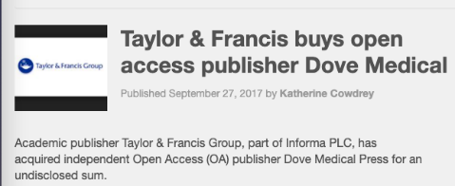
Rather than converting journals, big publishers are adding OA journals

Slide 30
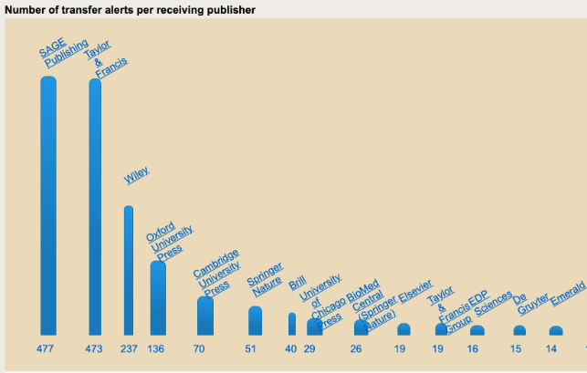
…and journals keep changing hands overall, often from smaller to larger publishers
https://journaltransfer.issn.org/statistics

Slide 31
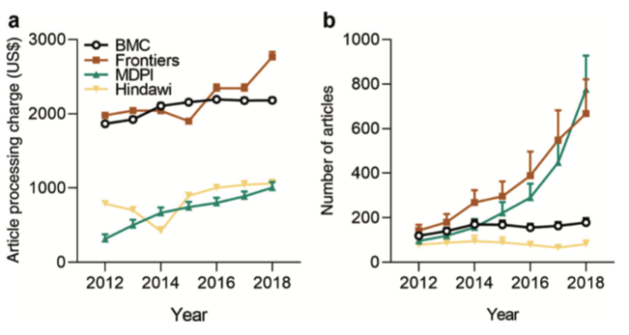
Prices of APC OA journals have increased as journals have become indexed and publication volumes have increased
(Khoo 2019 http://doi.org/10.18352/lq.10280)

Slide 32
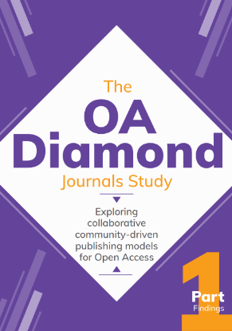
Diamond OA
“Since 2018, the share of diamond journal articles has been dwindling, which coincides with the increase in articles in APC-based journals.” [p.7]
“The OA diamond sector is diverse in terms of regions (45% in Europe, 25% in Latin America, 16% in Asia, 5% in the US/Canada) and disciplines (60% HSS, 22% science, 17% medicine). In Europe, more than half of them are based in one of the Eastern European countries.” [p.7]
“70% declared less than $/€10,000 annual costs” [p.7]
https://doi.org/10.5281/zenodo.4558704

Slide 33
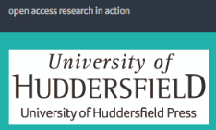
University presses

Slide 34
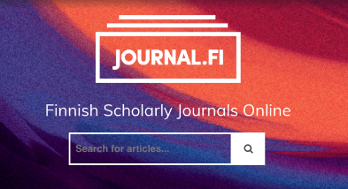
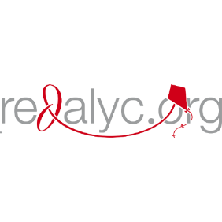
OA journal portals, one of the best things in OA so far?

Slide 35
Green open access

Slide 36
Green OA
Currently the most popular way to provide open access, also in Finland.
Very useful, but not a systemic game-changer on its own.
Signs of plateauing in many countries where there has been strong growth previously.
How will publishers react if growth continues and transformative agreements become the norm?
How long do we want to accept the common drawbacks of green OA (licensing, machine readability, delay) ?
http://openknowledge.community/dashboards/coki-open-access-dashboard/

Slide 37
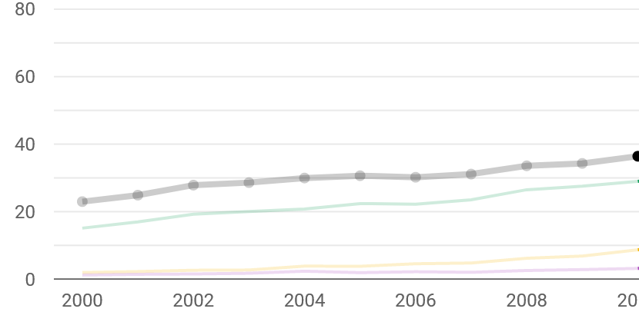
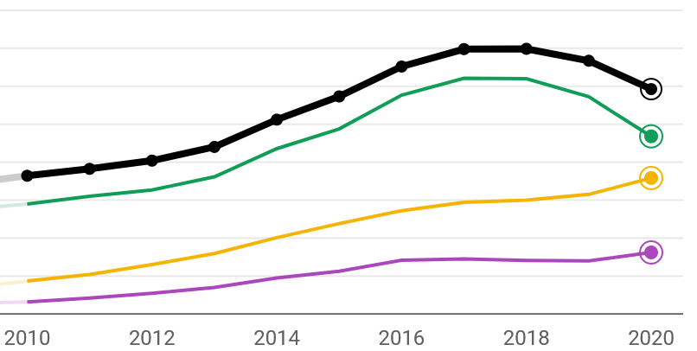
Share of articles OA in the UK and Northern Ireland
http://openknowledge.community/dashboards/coki-open-access-dashboard/

Slide 38
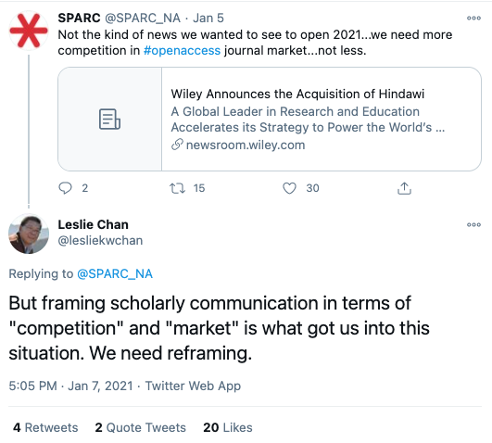
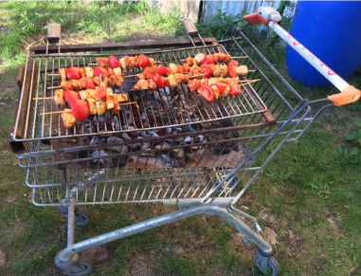
Is the only way to “win” not to play ?
https://twitter.com/lesliekwchan/status/1347197705014169601
https://www.reddit.com/r/funny/comments/4y7xjb/this_is_how_you_do_a_bbq_to_go/

Slide 39
Key takeaways
Science policy nationally and internationally should not work based on short-sighted economic decision-making.
Large commercial publishers are currently the only ones acting truly globally – Collective action is needed to make change happen, not just by research funders.
Funds should be directed to alternative infrastructures, models, and platforms.
If cost-effectiveness, equity, and/or access is a priority, reliance on current dominant international publishers needs to be lessened.
So far green OA has provided with a low cost option, it is not optimal and has some uncertainty for the future.

Slide 40
Thank you!

